Slide 1


USWDS Monthly Call
September 2024

Slide 2

Hi!
Thanks for being here!

Slide 3
Agenda
Featured sites
Product updates
Web Components landscape
Q&A

Slide 4
Featured sites

Slide 5

Pension Benefit Guaranty Corporation
pbgc.gov
Notes:
TK

Slide 6

Technology Transformation Services
tts.gsa.gov
Notes:
TK

Slide 7
Great work!

Slide 8
Product updates

Slide 9
USWDS 3.9.0
Still in progress

Slide 10
Key improvements in USWDS 3.9.0
Fixes a tab order bug in the mobile header
Fixes a keyboard/mouse interaction issue in date picker
Improves performance of input mask
Improves legibility of pagination links
Adds ability to add a custom breakpoint to utilities

Slide 11
New accessibility test pages
Checkbox, Radio button, Combo box
Next: Breadcrumb, Pagination, Side navigation, In-page navigation

Slide 12
Sunsetting v1 documentation site
Decommissioning at the end of 2024

Slide 13
Public discussions
Continued new component: Tabs
Accessibility: Uses for Slider component
Q&A: August monthly call
Notes:
Accessibility: https://github.com/uswds/uswds/discussions/6023

Slide 14
Web Components Landscape

Slide 15
Matt Henry
he/him
Engineering Lead USWDS

Slide 16
Jacline Contrino
she/her
UX Researcher USWDS Contractor

Slide 17
Web Components:
A big topic

Slide 18
We want to learn about…
Teams and resources
Documentation
Distribution
Structure
Performance

Slide 19
Stuff we’re doing
Landscape analysis
Surveys
Discussions
Interviews
Beta program

Slide 20
Survey findings

Slide 21
Participation was great!
115 respondents
50 different agencies

Slide 22
Teams

Slide 23
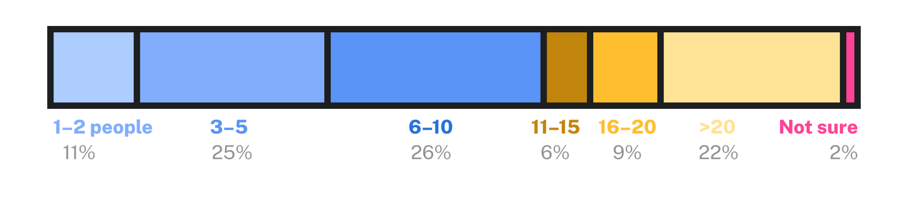
Overall team size
Half of respondents’ teams are between 3-10 people.
About 23% have more than 20 people.

Slide 24
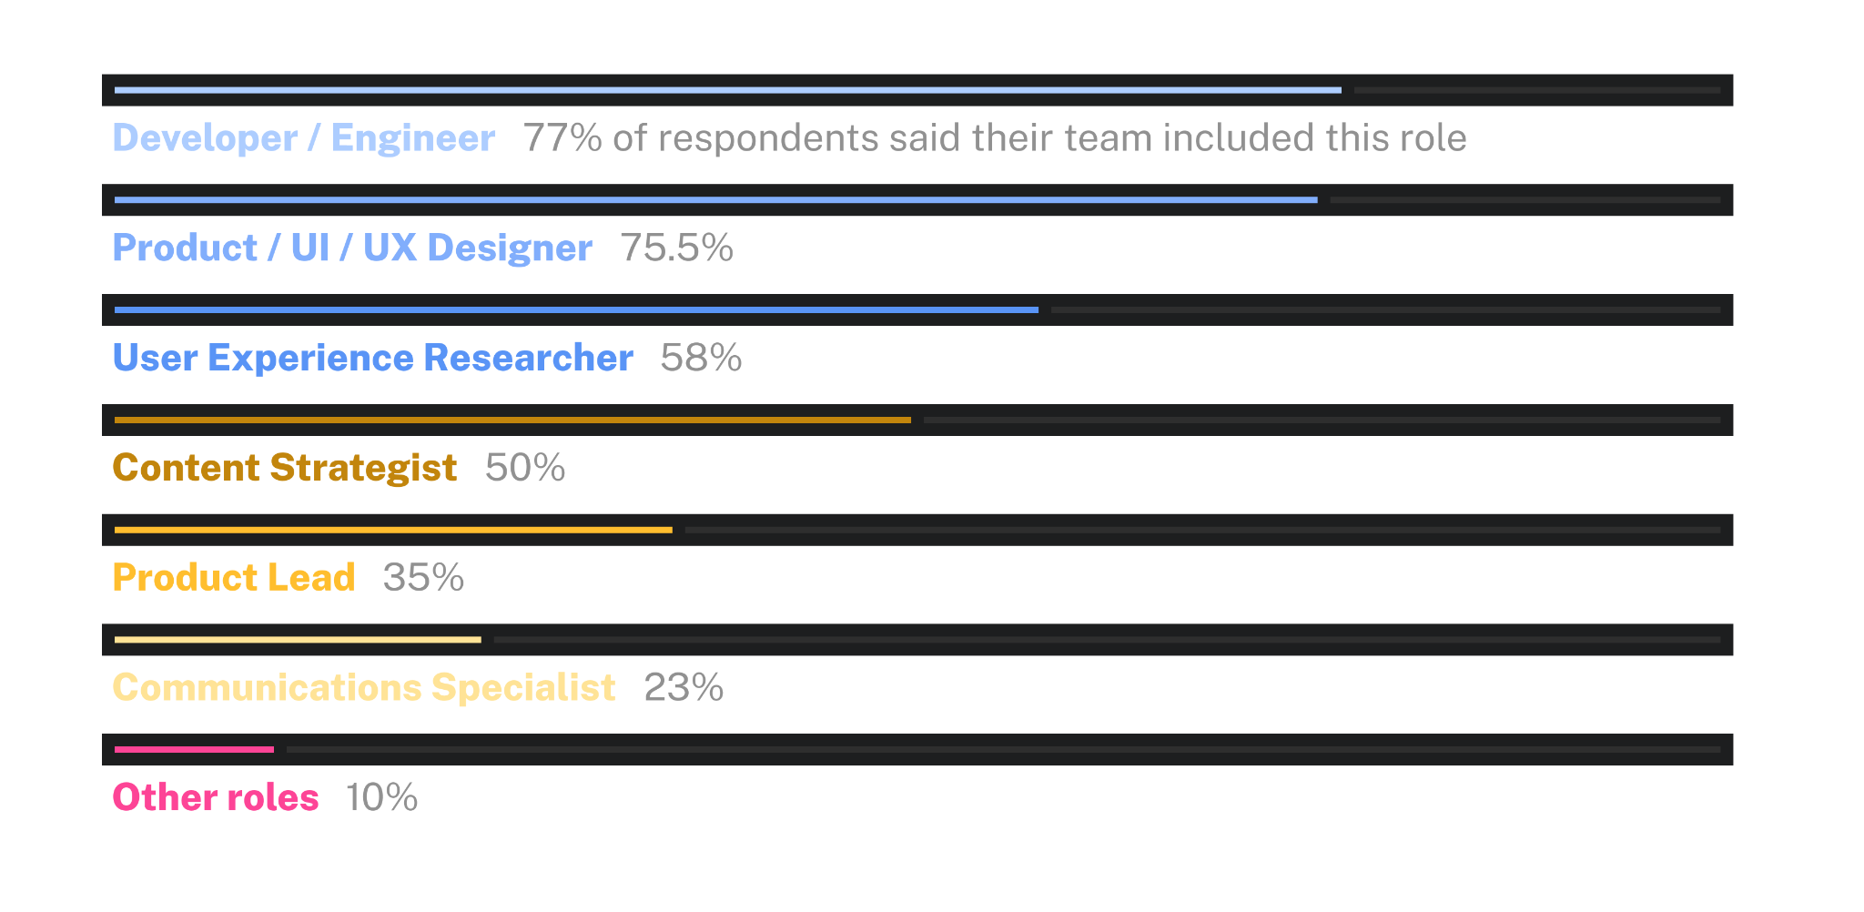
Roles represented by individuals on teams

Slide 25
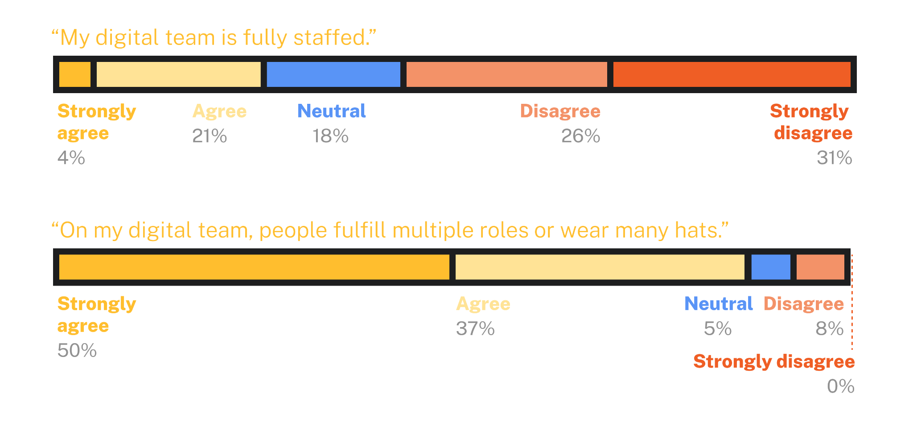
Team staffing and “wearing many hats”

Slide 26
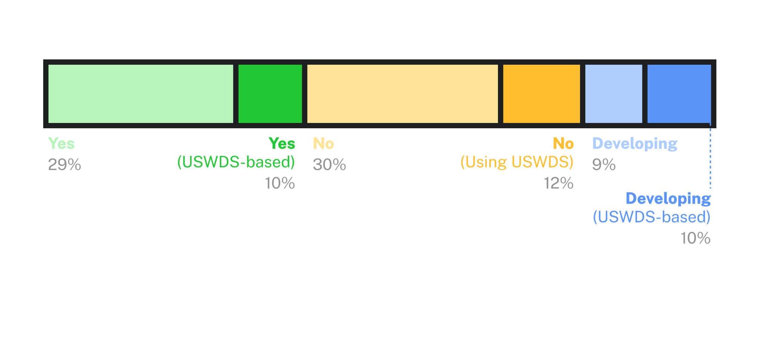
Does your product or agency have its own design system?
Of those that answered this question (82 respondents), a majority (70%) use or are currently developing a design system.

Slide 27
Technology

Slide 28
Technology use by government digital teams
Most common frameworks
React: 37%
Angular: 15%
“I don’t know”: 41%
Most common front-end programming languages
HTML
CSS
JavaScript
Most common package managers
npm: 30%
Yarn: 12%
CDN: 9%
pnpm: 4%
“I don’t know”: 56%

Slide 29
Takeaways

Slide 30
Survey Takeaways
Make Web Components easy to adopt for teams of any size
Consider providing documentation by task rather than by role
Focus on integration with tech stacks often used by government teams

Slide 31
Landscape analysis

Slide 32
Research questions

Slide 33
We want to learn about…
Documentation
Code structure
Code size and performance
Distribution

Slide 34
Collaboration for subject matter expertise

Slide 35
Design systems we used for our analysis
Government design systems
CA.gov Design System
CMS.gov Design System
Helsinki Design System
Ontario Design System
NHS.uk Design System
VA Design System
Non-government design systems
Carbon
Fluent Design System
GitHub Primer
Nord Design System
Patternfly (Redhat)
Shoelace
VMWare Clarity

Slide 36
Web Components
Documentation

Slide 37
Documentation helps you do what you need to do

Slide 38
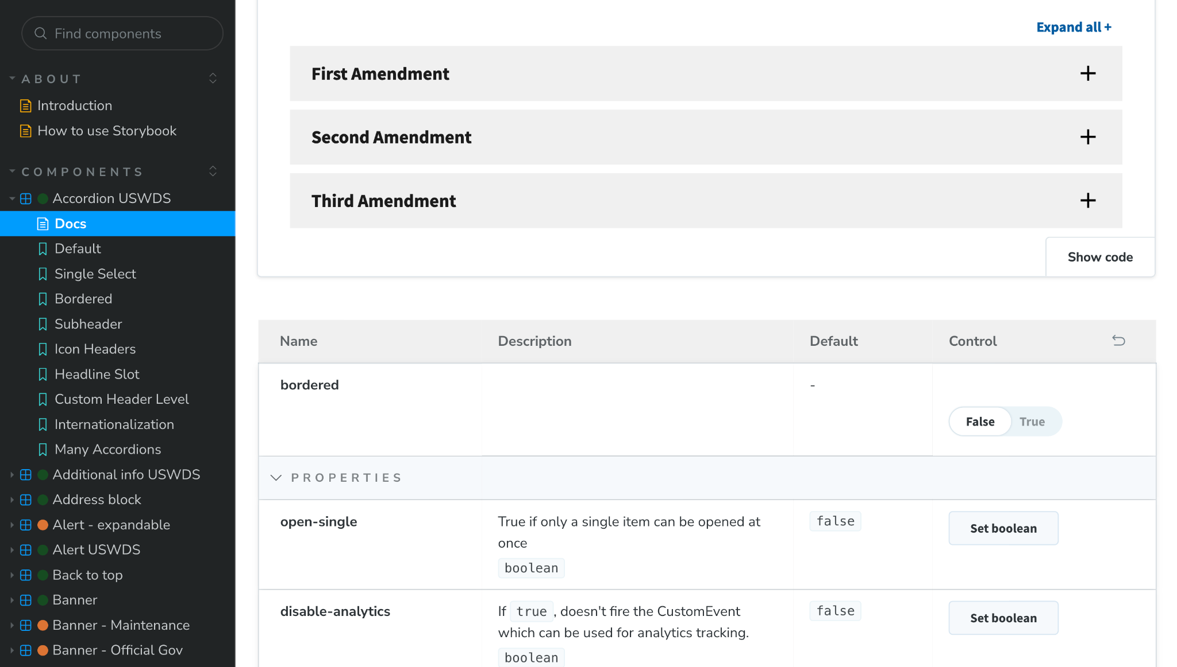
Interact with the component
Storybook
Notes:
TK

Slide 39
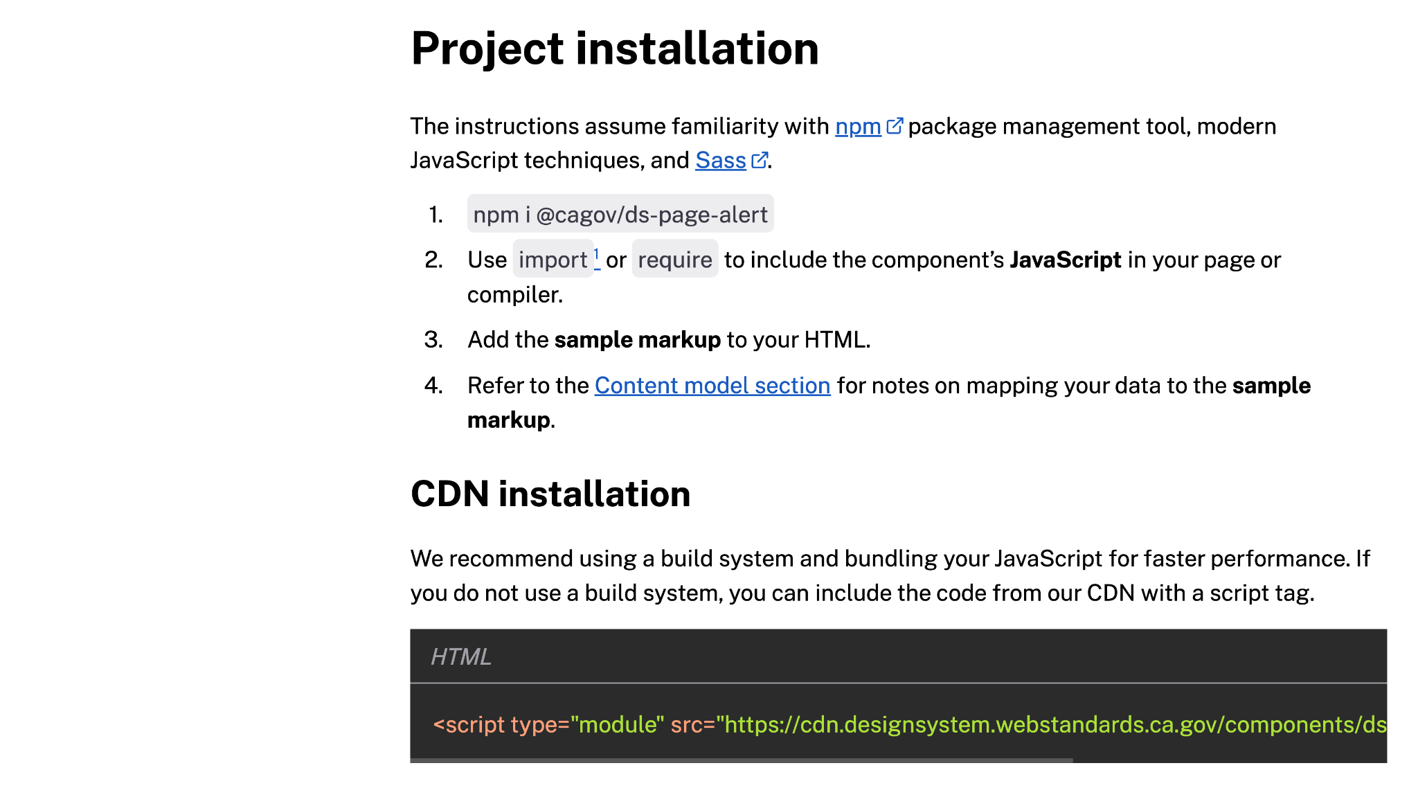
Install into a project
npm- and CDN-based instructions
Notes:
TK

Slide 40
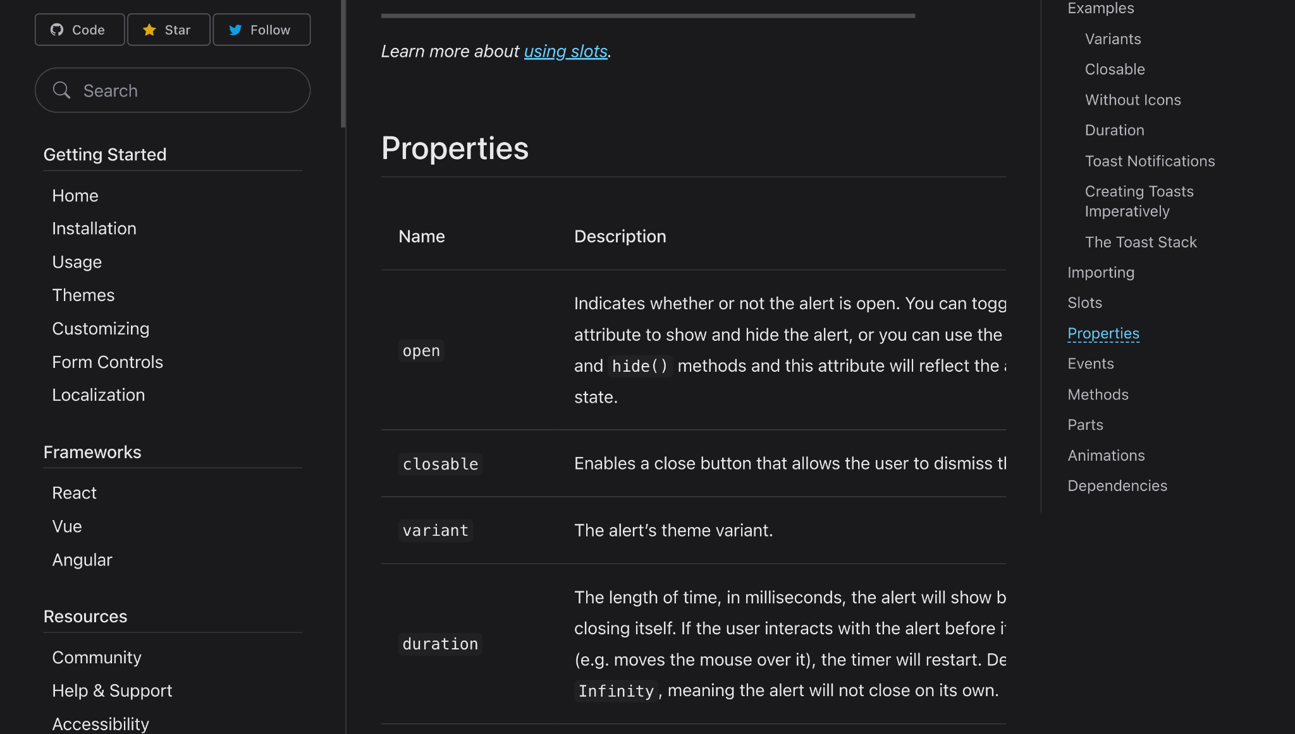
Configure and customize
Properties documentation
Notes:
TK

Slide 41
Elements of a Web Component API
Properties: Settings passed to component markup
Events: Emitted data based on a component interaction
Slots: Named content regions inside a component
Parts: Subsections of a component styleable with CSS
Tokens: CSS variables that influence component styling
Methods: JavaScript controls for component interactivity
Content model: Content-specific properties

Slide 42
Documentation commonalities
Consistent category organization
Frequently appear on the same page or in a page-level tab
Organized in a consistent table structure

Slide 43
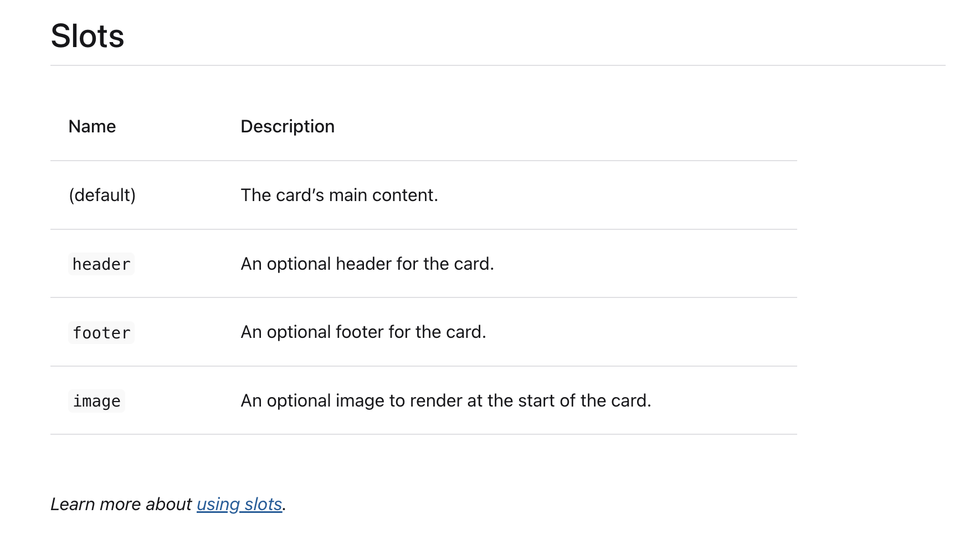
We like the idea of offering ways for users to learn more about how to use parts of Web Components

Slide 44
Documentation friction
CSS Parts lacking documentation
Design tokens either omitted, or having so many of them as to be difficult to browse
Is this type of documentation only for developers?

Slide 45
Multiple frameworks

Slide 46
Techniques for distinguishing formats
Tabs with separate code and guidance
Separate documentation pages
Separate documentation platform (Storybook)
Separate website

Slide 47
Status

Slide 48
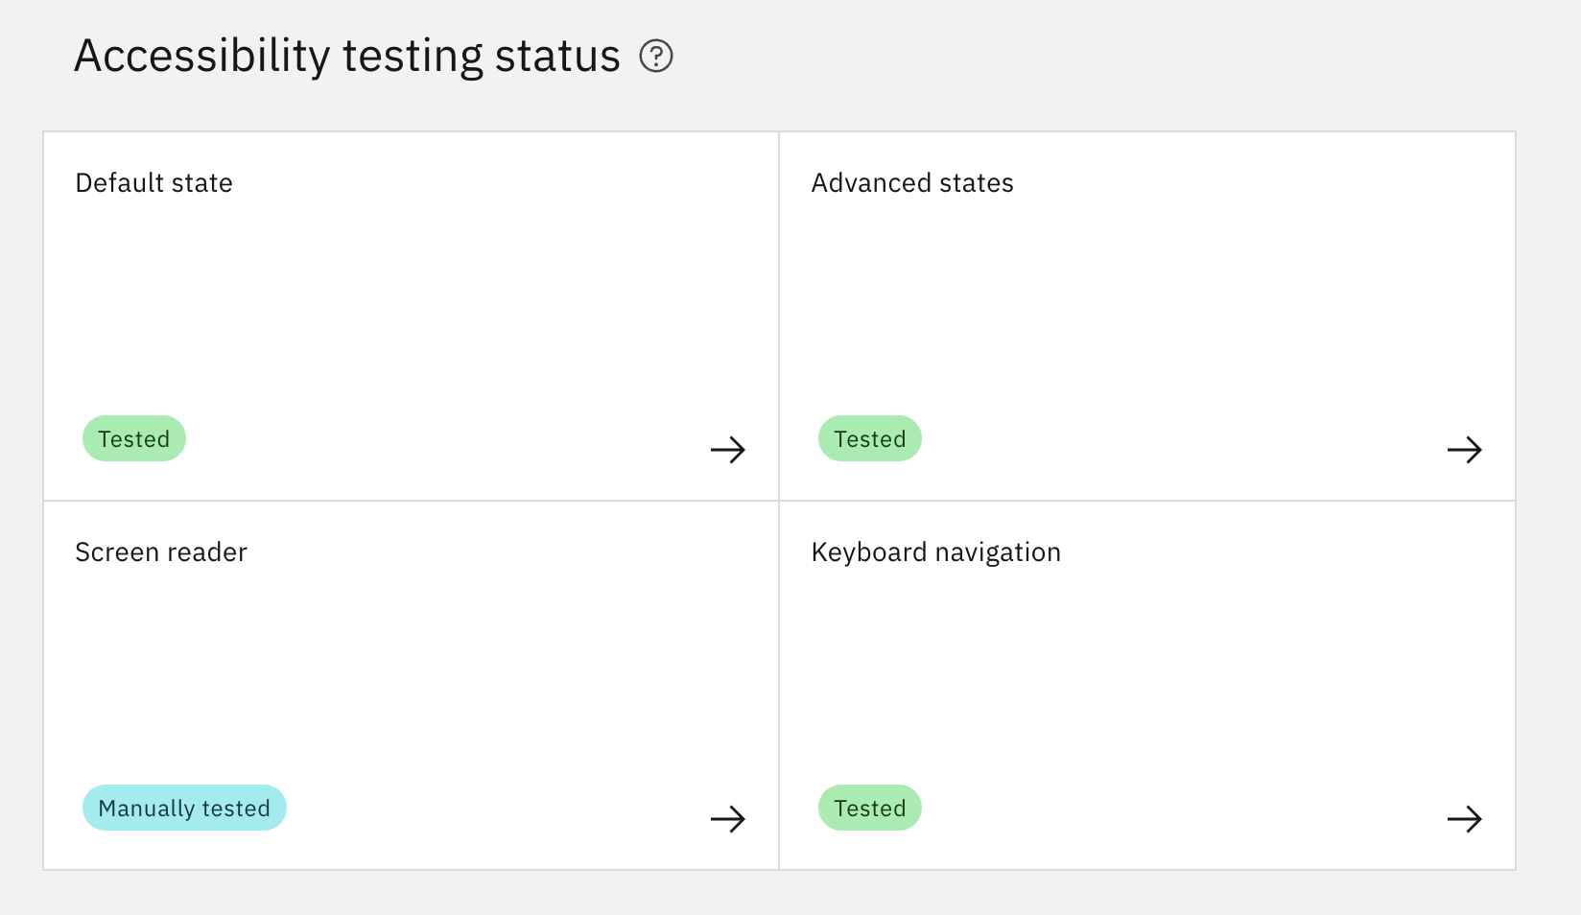
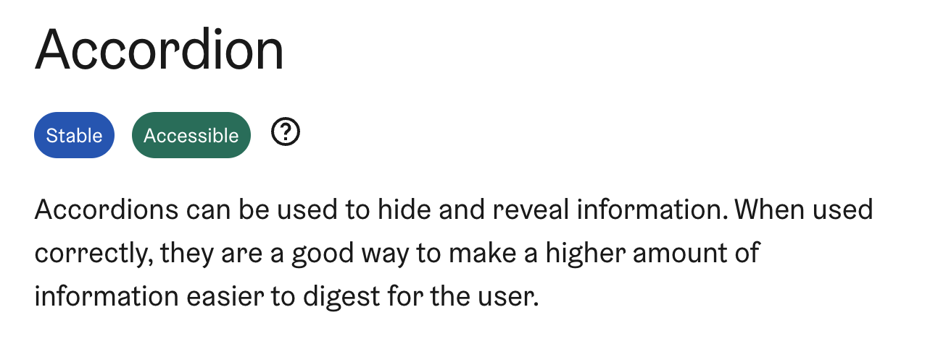
Accessibility status
Tags

Slide 49
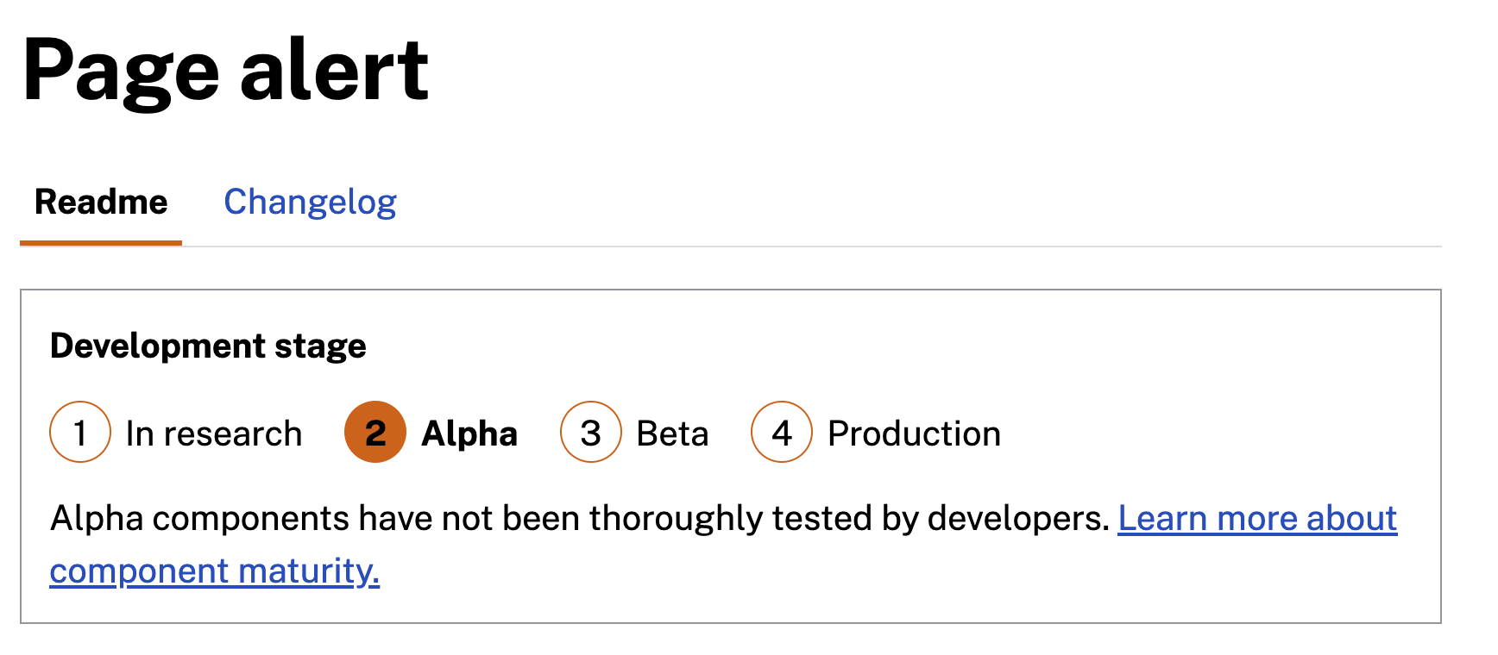
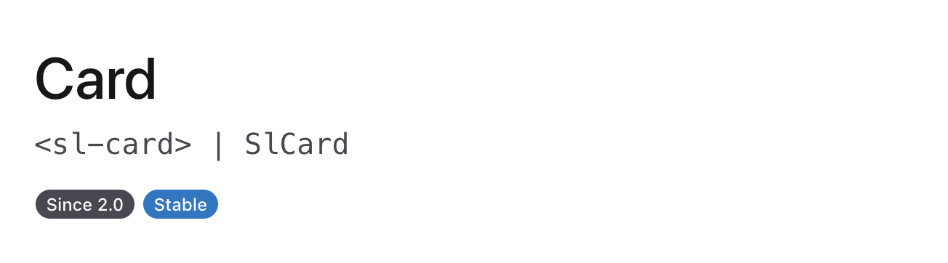
Component maturity
Step indicator; tags

Slide 50
Preliminary documentation thoughts
At-a-glance status confirmation
An obvious location for Web Components docs
Support interaction before installation
Component-level installation instructions
API guidance alongside an interactive component
A documentation-driven approach

Slide 51
Distribution

Slide 52
npm or CDN

Slide 53
Preliminary distribution thoughts
Component-level distribution
npm works well for bundling and optimizing
A CDN makes a component super simple to install

Slide 54
Component structure

Slide 55
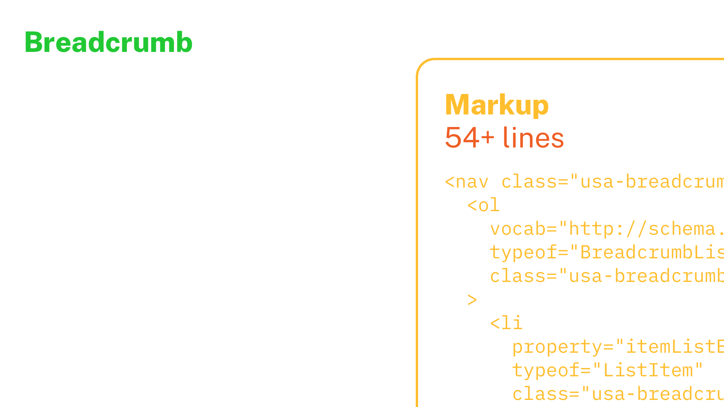
Remember this from April 2024?
<usa-breadcrumb home="url" rdfa>
<a href="url">Books</a>
<a href="url">Fiction</a>
<a href="url">Novels</a>
<a href="url">Moby Dick</a>
</usa-breadcrumb>

Slide 56
Simplified HTML
Structured content with simplified form
<usa-breadcrumb home="url" rdfa>
<a href="url">Books</a>
<a href="url">Fiction</a>
<a href="url">Novels</a>
<a href="url">Moby Dick</a>
</usa-breadcrumb>

Slide 57
Standard HTML
Structured content with complete semantic form
<usa-breadcrumb home="url" rdfa>
<ol>
<li><a href="url">Books</a></li>
<li><a href="url">Fiction</a>/li>
<li><a href="url">Novels</a>/li>
<li><a href="url">Moby Dick</a>/li>
</ol>
</usa-breadcrumb>

Slide 58
Modularized markup
Structured content abstracted with custom elements
<usa-breadcrumb home="url" rdfa>
<usa-bc-link href="url">Books</usa-bc-link>
<usa-bc-link href="url">Fiction</usa-bc-link>
<usa-bc-link href="url">Novels</usa-bc-link>
<usa-bc-link href="url">Moby Dick</usa-bc-link>
</usa-breadcrumb>

Slide 59
Self-contained
Content fully abstracted as properties
<usa-breadcrumb home="url" rdfa links="
[
{"href": "url", "label": "Books"},
{"href": "url", "label": "Fiction"},
{"href": "url", "label": "Novels"},
{"href": "url", "label": "Moby Dick"},
]">
</usa-breadcrumb>

Slide 60
How do systems represent the parts of a component?

Slide 61
Is content content?
Or data?

Slide 62
Native elements or custom elements?

Slide 63
Our findings are… inconclusive

Slide 64
Beyond design systems

Slide 65
Performance and progressive enhancement

Slide 66
Content inside renders
whether or not JavaScript runs
or runs promptly
<details>
<summary>A succinct summary</summary>
Additional details about the summarized item.
<details>
<ds-details>
<details>
<summary>A succinct summary</summary>
Additional details about the summarized item.
<details>
</ds-details>

Slide 67
Edge cases at scale

Slide 68
Performance

Slide 69
Performance is complicated

Slide 70
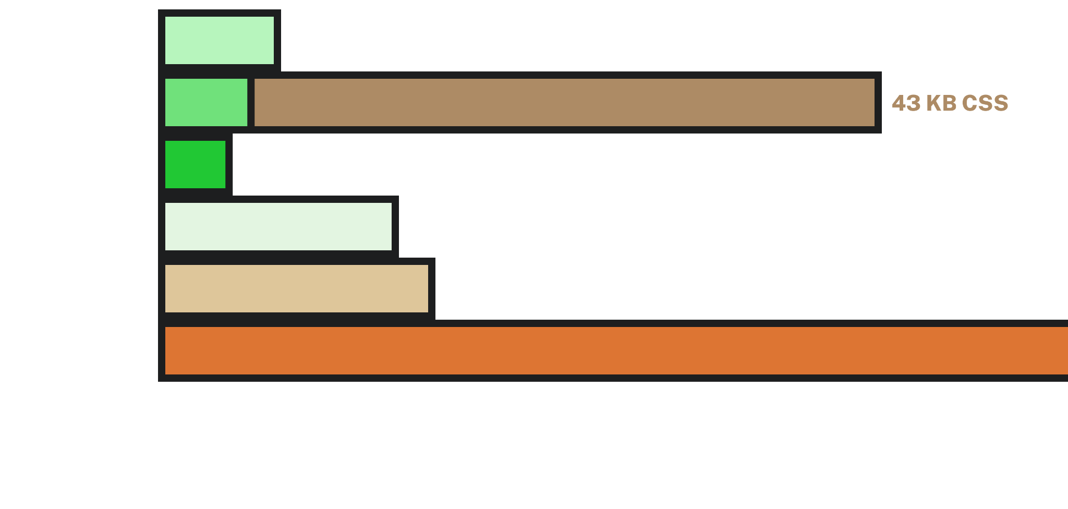
Alert code size (not gzipped)

Slide 71
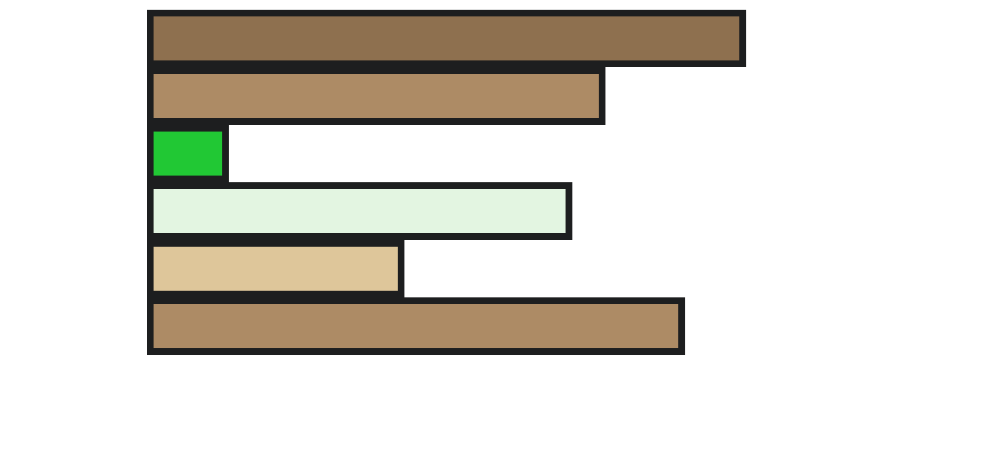
Accordion code size (not gzipped)

Slide 72
Balance

Slide 73
Next steps: Principles

Slide 74
Q&A
Notes:
DW

Slide 75
Next month
October: Engineering/product principles
#uswds-public
github.com/uswds
designsystem.digital.gov
Notes:
DW

